Slide 1
INTRODUCTION TO TRIGONOMETRY
Module 1 of 3
Ratna Rathor
AECS-2
Mumbai

Slide 2
Trigonometric Ratios

Slide 3
The word 'trigonometry' is derived from the Greek words 'tri' (meaning three), 'gon' (meaning sides) and 'metron' (meaning measure).
In fact, trigonometry is the study of the relationship between the sides and angles of a triangle.
‘tri’ – Three
‘gon’ – Sides
Metron – Measure
Notes:
complete

Slide 4
OBJECTIVES
At the end of this lesson, you will be able to-
State the trigonometric ratios of an acute angle in a right-angled triangle.
Calculate the trigonometric ratios of an acute angle using Pythagoras Theorem.
Establish some identities involving these ratios, called Trigonometric Identities.

Slide 5
Trigonometry is said to be the most important
mathematical relationship ever discovered.
Triangles are one of the most simple forms found in Nature, but their mathematics has vital importance, especially where precise distance measurements are needed.

Slide 6
Applications in Real Life
In ancient timed, it was used for astronomy
in finding the distance of stars.
Finding the radius of the earth
Finding the height of hills, buildings, trees etc.
Navigation – Airplane, Ships etc.
Defence

Slide 7

Historical Background
The history of trigonometry dates back to the early age of Egypt and Babylon. Angles were then measured in degrees.
It was then advanced by the Greek astronomer Hipparchus in the second century B.C. He compiled a trigonometric table that measured the length of a chord subtending various angles in a circle of a fixed radius r.
He is known as the father of TRIGONOMETRY.
Notes:
Father of trigonometry

Slide 8
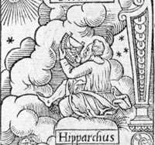
Hipparchus is considered by some as the greatest astronomer. He was the first Greek to develop quantitative and accurate models for the motion of the Sun and the Moon.
With his solar and lunar theories and his numerical trigonometry, he was probably the first to develop a reliable method to predict solar eclipses.

Slide 9
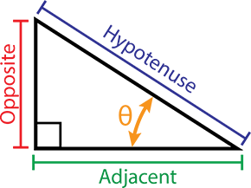
Right Triangle
The hypotenuse of a right triangle
is always the side opposite the
right angle. It is the longest side
in a right triangle.
The adjacent leg is the other side that is adjacent to angle θ (theta).
It is also sometimes called as base.
The opposite side is the side that is opposite to angle θ (theta). It is also sometimes called perpendicular.
Notes:
Right triangle

Slide 10
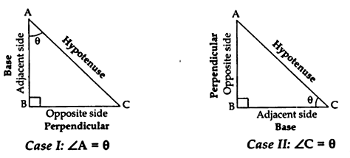
Right Triangle
The sides are always defined with respect to acute angle ‘A’ or angle ‘C’.

Slide 11
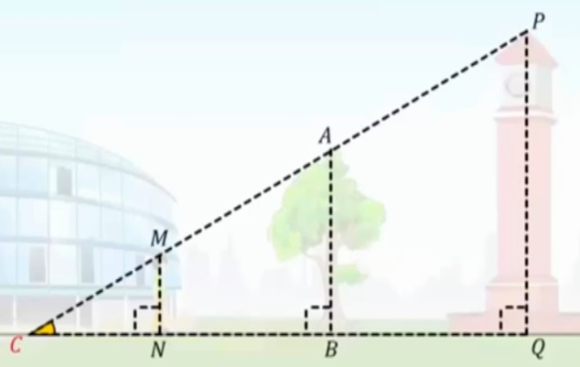
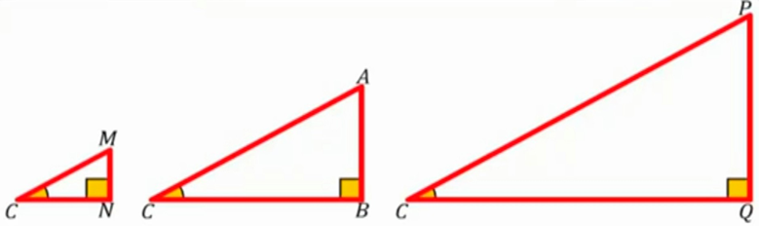
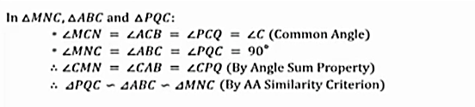
To find the height of the clock tower and the tree

Slide 12
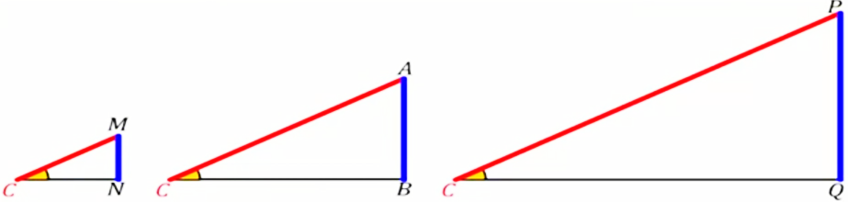
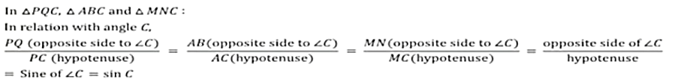

Sine Function/Ratio(Sin)

Slide 13
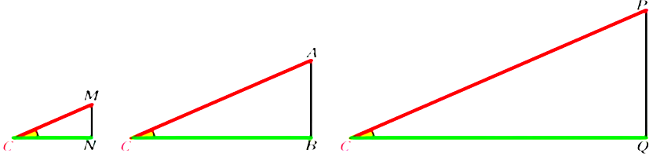
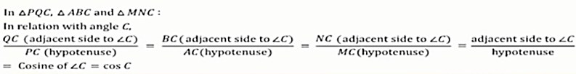

Cosine Function/Ratio(Cos)

Slide 14
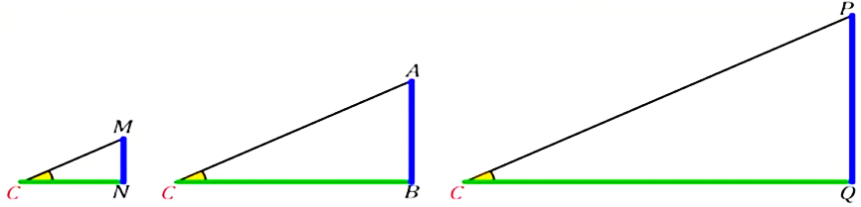


Tangent Function/Ratio (Tan)

Slide 15
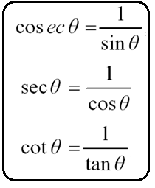
Reciprocal Functions/Ratios
The other trigonometric ratios are cosecƟ, secƟ and cotƟ.
The ratios cosecƟ, secƟ and cotƟ are the reciprocals of the ratios sinƟ, cosƟ and tanƟ respectively.

Slide 16
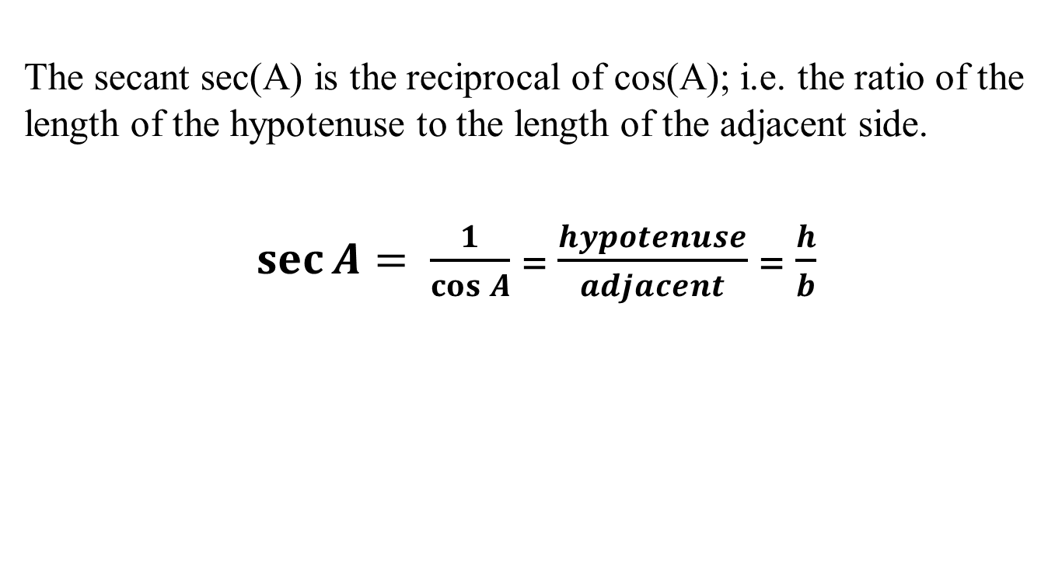
Secant (Sec) Function/Ratio
The secant sec(A) is the reciprocal of cos(A); i.e. the ratio of the length of the hypotenuse to the length of the adjacent side.
$\sec{A= \frac{1}{\cos{A}}}$ = $\frac{hypotenuse}{adjacent}$ = $\frac{h}{b}$

Slide 17

Cosecant (Cosec)Function/Ratio
The cosecant or cosec(A), is the reciprocal of sin(A); i.e. the ratio of the length of the hypotenuse to the length of the opposite side.
$\operatorname{cosec}{A= \frac{1}{\sin{A}}}$ = $\frac{hypotenuse}{opposite}$ = $\frac{h}{a}$

Slide 18

The cotangent cot(A) is the reciprocal of tan(A); i.e. the ratio of the length of the adjacent side to the length of the opposite side.
Cotangent(Cot) Function/ Ratio
$\cot{A= \frac{1}{\tan{A}}}$ = $\frac{adjacent}{opposite}$ = $\frac{b}{a}$

Slide 19
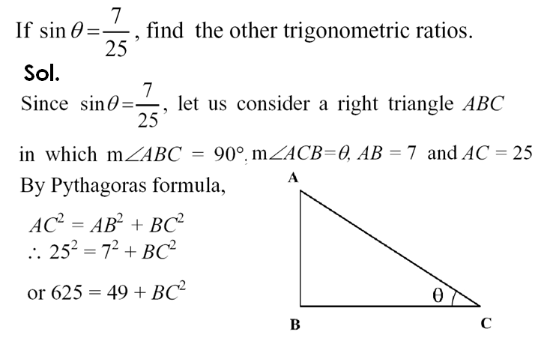

Example

Slide 20



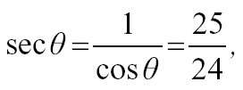


Slide 21
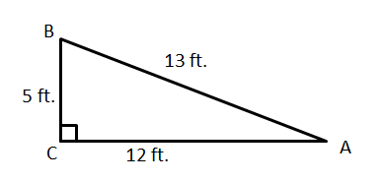
RECAPITULATION
Using the given figure, find all the trigonometric ratios for angle A and B.

Slide 22
THANK YOU

